Slide 1

Predictive Modeling Of In-hospital Mortality Following Elective Surgery
BY Jahnavi
jithendra
Navanth Teja

Slide 2

Introduction
In today's healthcare environment, choosing the right facility based on performance metrics is a critical factor for ensuring effective patient care. Our Healthcare Facility Performance Prediction System addresses this need by leveraging location-based recommendations.
Objective: The goal of this system is to help patients make informed decisions when selecting healthcare facilities by predicting and ranking facilities based on their performance in treating specific medical conditions. The system integrates advanced data processing and machine learning techniques to provide personalized, efficient, and effective healthcare access.

Slide 3
Problem Statement
Problem Statement:
Identifying how many in hospital mortalities has been happened in a specific facility, identifying the root causes of these mortalities like past chronic diseases, health care or any other. Predicting these using machine learning will help reduce in hospital mortality. provide the patient with the facility that is near him which has less mortality rates Along with that, we are also recommending the nearest performance-based facility which improves the patient chances of survival
The system should take the patient’s location as input and recommend the best-performing facilities nearby, ensuring personalized and efficient healthcare access.
Solution Approach
Input Data:
Patient location (e.g., ZIP Code, city, or coordinates).
Optional: Patient's medical condition (e.g., "pneumonia," "heart attack").
Processing Workflow:
Identify healthcare facilities within a specific radius (e.g., 10-50 miles) from the patient's location.
Filter facilities based on their Measure Name related to the medical condition (e.g., "Death rate for pneumonia patients").
Predict or retrieve performance scores for facilities using an ML model.
Rank facilities based on their predicted scores and geographic proximity.
Output:
A ranked list of facilities with the following details:
Facility Name and Address.
Performance Score.
Distance from the patient’s location.
Contact information (e.g., phone number).
Measure-specific performance (e.g., mortality or complication rates).

Slide 4
ABSTRACT
In the past few years, the patient safety post the operation has been increased but in hospital mortality models, a concern. In this study, we aim to develop a predictive model that would forecast the mortality rate. By using machine learning models we identify the prominent factors that affect the mortality rate and provide the patient with the facility that is near him which has less mortality rates.

Slide 5
Description of Dataset Fields:
Facility ID: Unique identifier for each healthcare facility.
Facility Name: Name of the healthcare facility.
Address: Physical address of the facility.
City/Town: The city or town where the facility is located.
State: The state in which the healthcare facility is located (includes US states and territories).
ZIP Code: Postal code for the facility's address.
County/Parish: The county or parish where the facility is located.
Telephone Number: Contact number of the healthcare facility.
Measure ID: Identifier for the health measure or metric being reported.
Measure Name: Name of the health measure or metric being evaluated.
Compared to National: Comparison of the facility's performance to the national standard (e.g., Better, Worse, No Different).
Denominator: The number of cases or participants used in the measure.
Score: The actual score or value of the facility's performance (often includes "Not Available").
Lower Estimate: The lower bound of the confidence interval for the measure score.
Higher Estimate: The upper bound of the confidence interval for the measure score.
Footnote: Additional notes or explanations (may contain missing values).
Start Date: Start date of the data reporting period.
End Date: End date of the data reporting period.

Slide 6

Business Need
Business Need for the Healthcare Facility Performance Prediction System
Improved Access to Quality Care: Helps patients find the best healthcare facilities based on location and medical needs.
Personalized Recommendations: Tailors suggestions to each patient's condition, ensuring optimal care.
Optimized Healthcare Resources: Assists providers in improving services and allocating resources efficiently.
Efficiency and Convenience: Saves time by presenting a ranked list of nearby hospitals, minimizing delays.
Data-Driven Decision Making: Provides insights for better planning and policy-making for stakeholders.
Increased Patient Trust: Builds confidence through transparent facility performance data.
Market Differentiation: Allows healthcare providers to stand out by showcasing their performance quality.

Slide 7
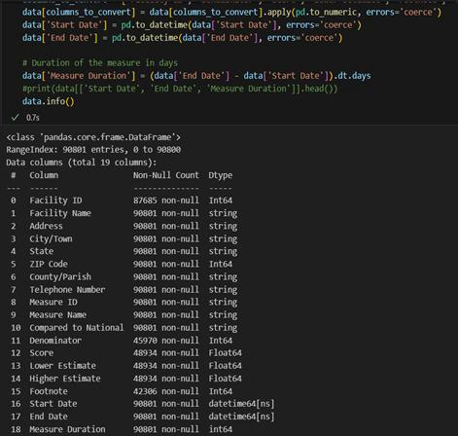
METHODOLOGY
converted all the features into their respective data types as follows
For feature engineering, we have created 2 new features like surgical season and score per denominator. Also, we have dropped all the irrelevant columns like start date, end date, footnote, facility id etc. While doing feature engineering we have used label encoding for features zip code, measure id and compared to national. For the mortality prediction we have used score feature and created 3 categories (Low, Medium, High).

Slide 8
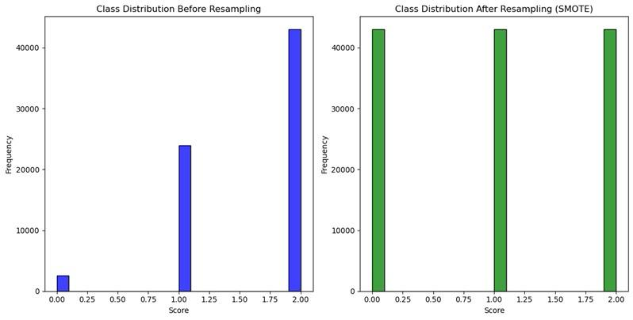
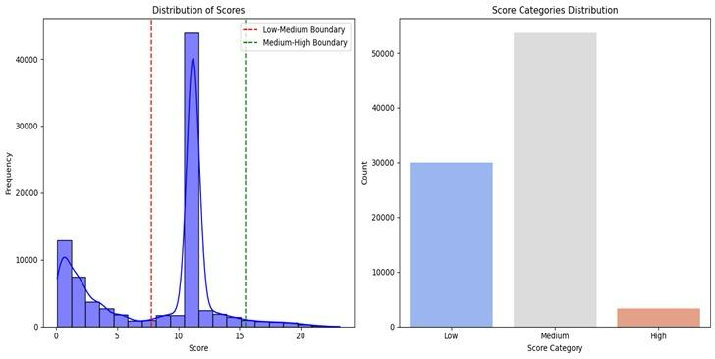
Comparison between addressing imbalancing data and feature engineering
Addressing Imbalanced Data using Smote
Feature Engineering

Slide 9
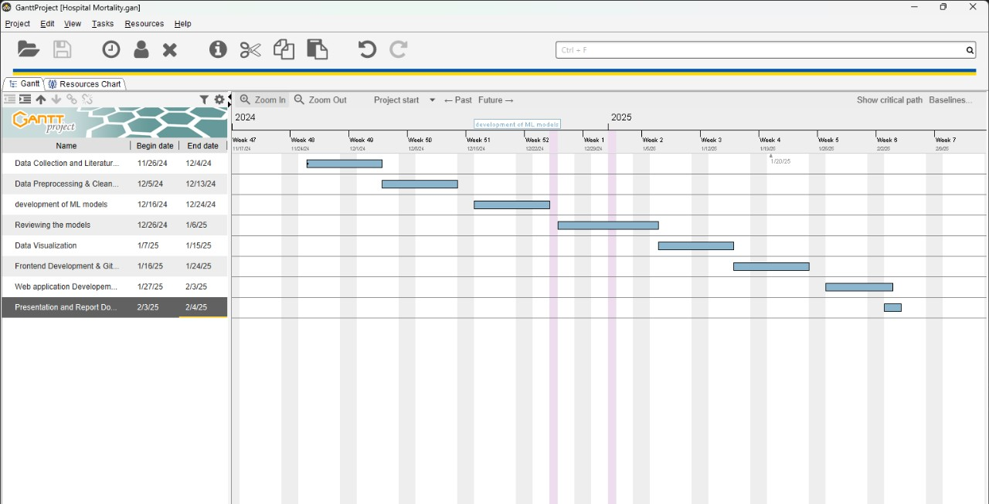

Slide 10
Model Implementations:
The following function-based models have been implemented:
Logistic Regression
Random Forest Classifier
Support Vector Machine (SVM)
K-Nearest Neighbor (KNN)

Slide 11
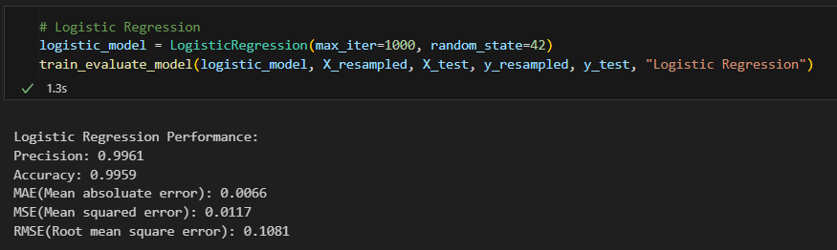
Logistic Regression
It is a linear classifier, works well separating linearly We can separate the data into different score categories

Slide 12
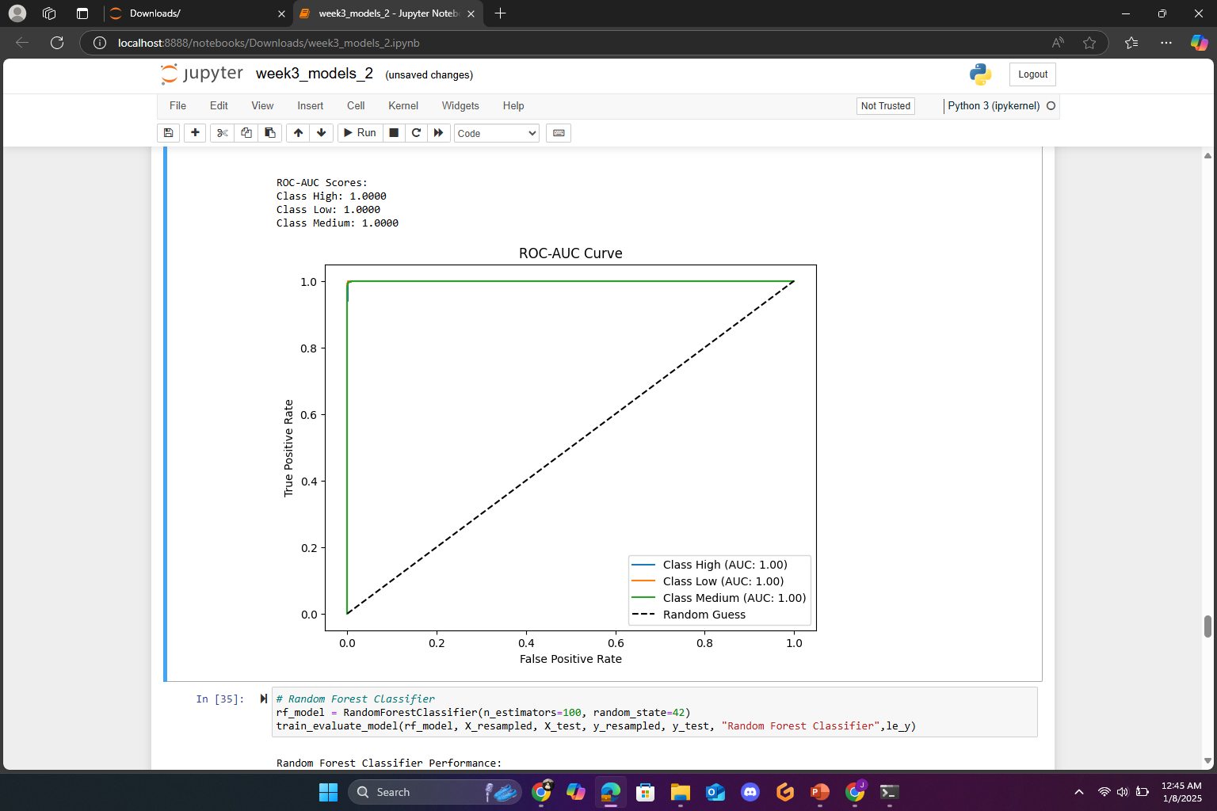
ROC-AUC Curve
Results:
The Logistic Regression has completely classified this dataset, which is reflected by the ROC-AUC scores of 1.00 for all three classes: High, Low, and Medium. This excellent performance is visually represented through the Receiver Operating Characteristic (ROC) curve where the curves for each class reach the top-left corner, hence having high sensitivity (True Positive Rate) with high specificity (low False Positive Rate).
It has indeed separated all the classes without misclassifications, as supported by the AUC score of 1.00 for each class. That means the model is dealing with the features of the data with high accuracy.
Model Strength:
That perfect ROC-AUC scores can be realized shows the strength of the Logistic Regression algorithm in handling the dataset. It ensemble reduces overfitting by averaging predictions over multiple decision trees.

Slide 13
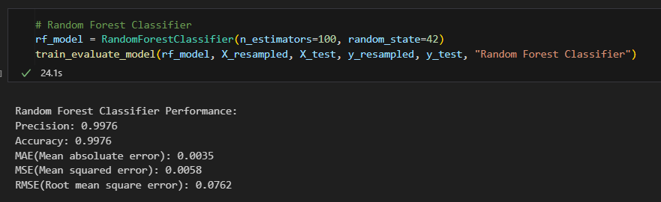
Random Forest Classifier
It can handle complex, non-linear patterns Provides generalization performance and avoids over fitting

Slide 14
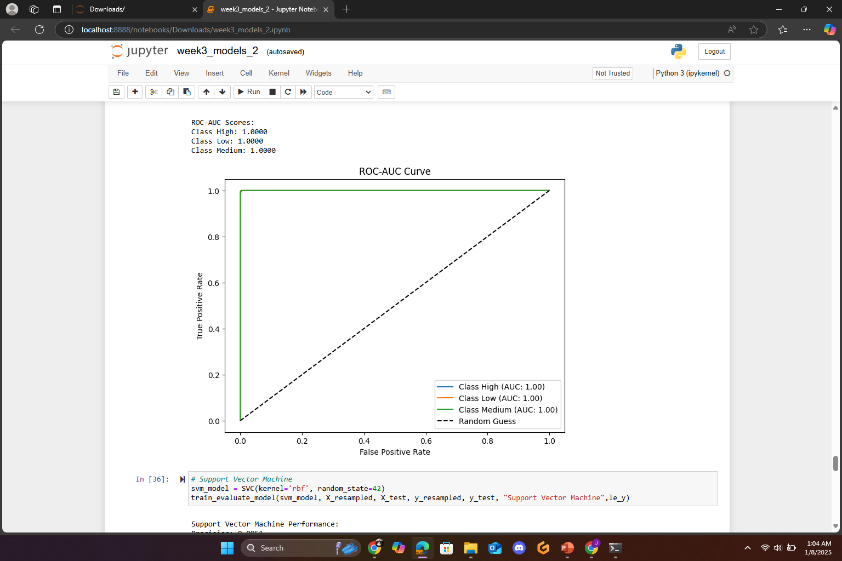
Random Forest Classifier
ROC-AUC Curves:
The ROC-AUC curve shown in the image measures how well the classifier distinguishes between classes. An AUC of 1.0 for all classes (High, Medium, Low) indicates perfect classification without errors. This suggests your model has achieved exceptional performance.
The straight diagonal (dotted) line represents random guessing. The fact that your curves hug the top-left corner shows that the Random Forest Classifier has a much higher predictive power.

Slide 15
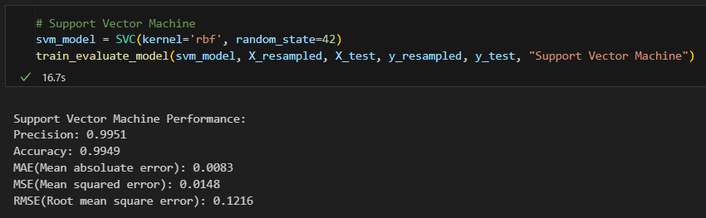
Support Vector Machine
If there are any non-linear boundaries in our target variable, this will capture Goes well with the class balanced data(SMOTE)

Slide 16
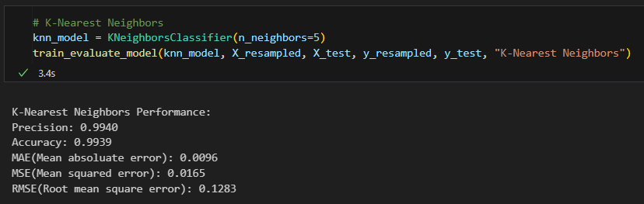
K-Nearest Neighbor
Captures complex, non-linear relationships which logistic regression misses Since scaling is performed, KNN is more suited

Slide 17
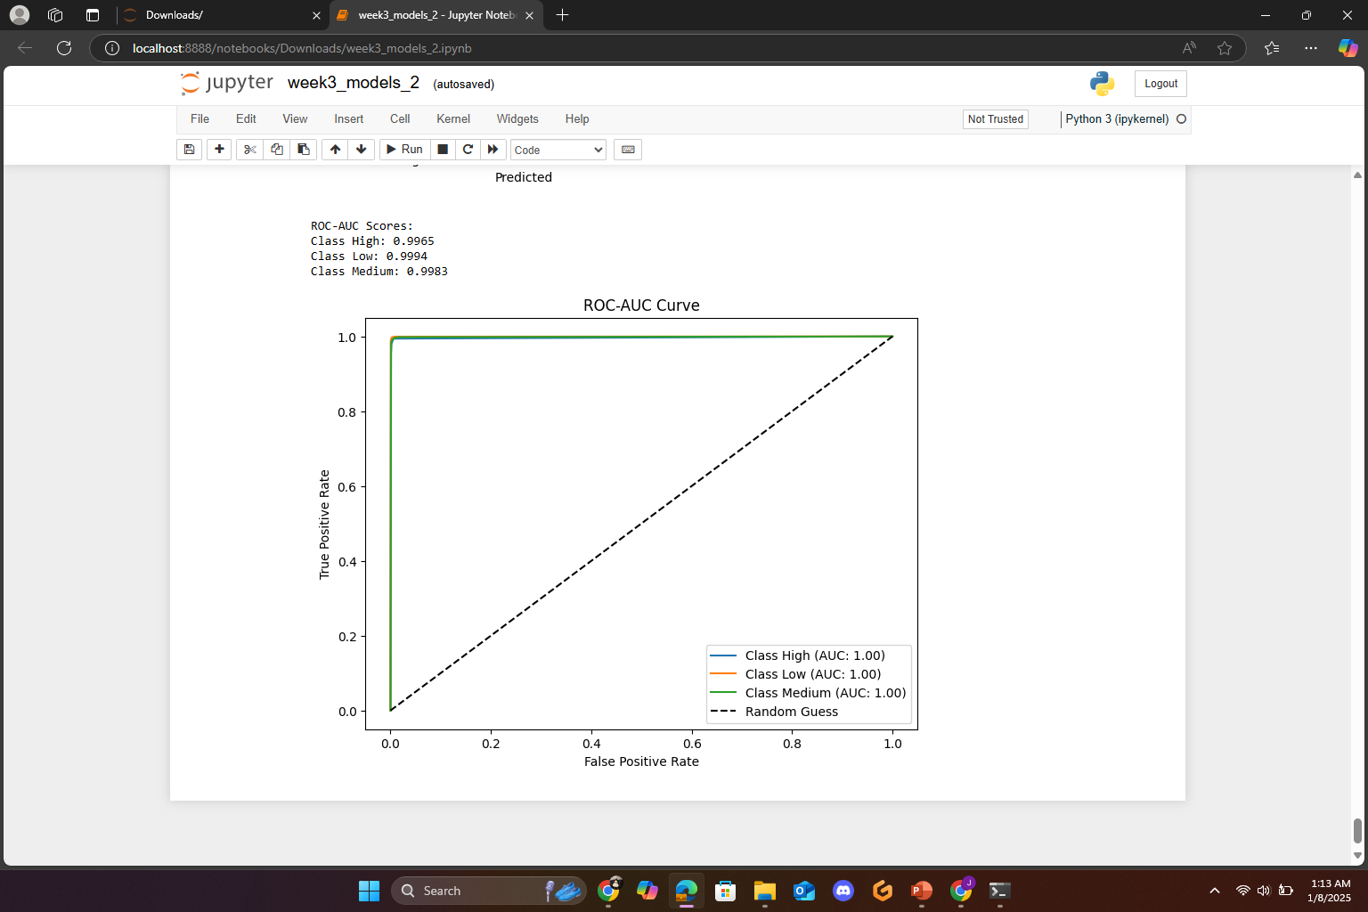
K-Nearest Neighbor
ROC-AUC Curves:
It measures how well the K-Nearest Neighbors (KNN) classifier distinguishes between classes. An AUC of 1.00 for all classes (High, Medium, Low) indicates perfect classification without errors. This suggests your model has achieved exceptional performance.
The straight diagonal (dotted) line represents random guessing. The fact that your curves hug the top-left corner demonstrates that the KNN classifier has achieved significantly higher predictive power compared to random guessing.

Slide 18
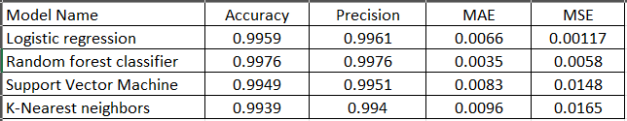
Comparison of the models
Random Forest Classifier has the best accuracy and precision

Slide 19
SMART HOSPITALS FINDER PERSONALIZED HEALTH CARE RECOMMENDATIONS
Patients struggle to find the best hospitals for specific medical conditions. Existing hospital search platforms lack personalization and real-time data. Timely healthcare decisions can significantly improve patient outcomes.
Hospital Finder Users enter their location and medical condition. The system fetches personalized hospital recommendations based on real-time data. Additional filtering for hospital performance metrics (e.g., mortality rates, treatment success).
Key Features:
User-Friendly Search
Location-based filtering
Condition-specific hospital recommendations
Additional symptom-based customization

Slide 20

Technology Stack:
Frontend: React.js Backend: Flask (Python) Database: MySQL APIs: Geolocation, Hospital Data APIs Hosting: Local Host
Impact & Benefits: ✔ Faster hospital discovery for patients ✔ Helps users make data-driven healthcare choices ✔ Improves access to quality medical services ✔ Can integrate with ambulance services & telemedicine

Slide 21
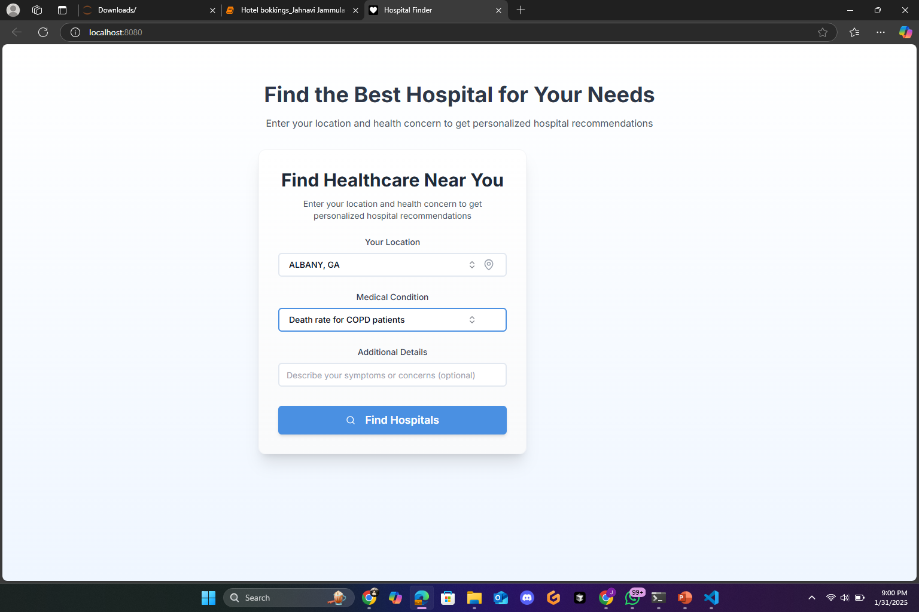

Slide 22
Insightful analysis of the hospital finder
The Hospital Finder application is successfully displaying personalized hospital recommendations based on user input.
For Example:
The user searched for hospitals in Albany, GA, focusing on the death rate for COPD patients. The system categorized the results into:
Hospitals within Albany, GA
Hospitals within the state but outside Albany, GA

Slide 23
City VS State Hospital Performance
City vs. State Hospital Performance
Phoebe Putney Memorial Hospital (Albany, GA)
Performance: Good
Patients Count: 206
Mortality Rate Estimate: 8.9% - 16.0%
Insight: While this hospital is in the user’s city, its mortality rate range is relatively higher compared to other state hospitals.
State Hospitals: Better Performance
Piedmont Henry Hospital: Stockbridge, GA: Excellent
Mortality Rate: 0% - 0.71%
Patients Count: 4,935
Doctors Hospital Augusta, GA: Excellent
Mortality Rate: 0% - 0.6%
Patients Count: 3,769
Memorial University Medical Center Savannah, GA: Excellent
Mortality Rate: 0% - 0.57%Patients Count: 7,713
Key Takeaway: The state hospitals have significantly lower mortality rates and higher patient volumes, indicating better performance for COPD-related care.
If the user is looking for better survival rates, traveling to a hospital outside Albany might be a better choice.

Slide 24
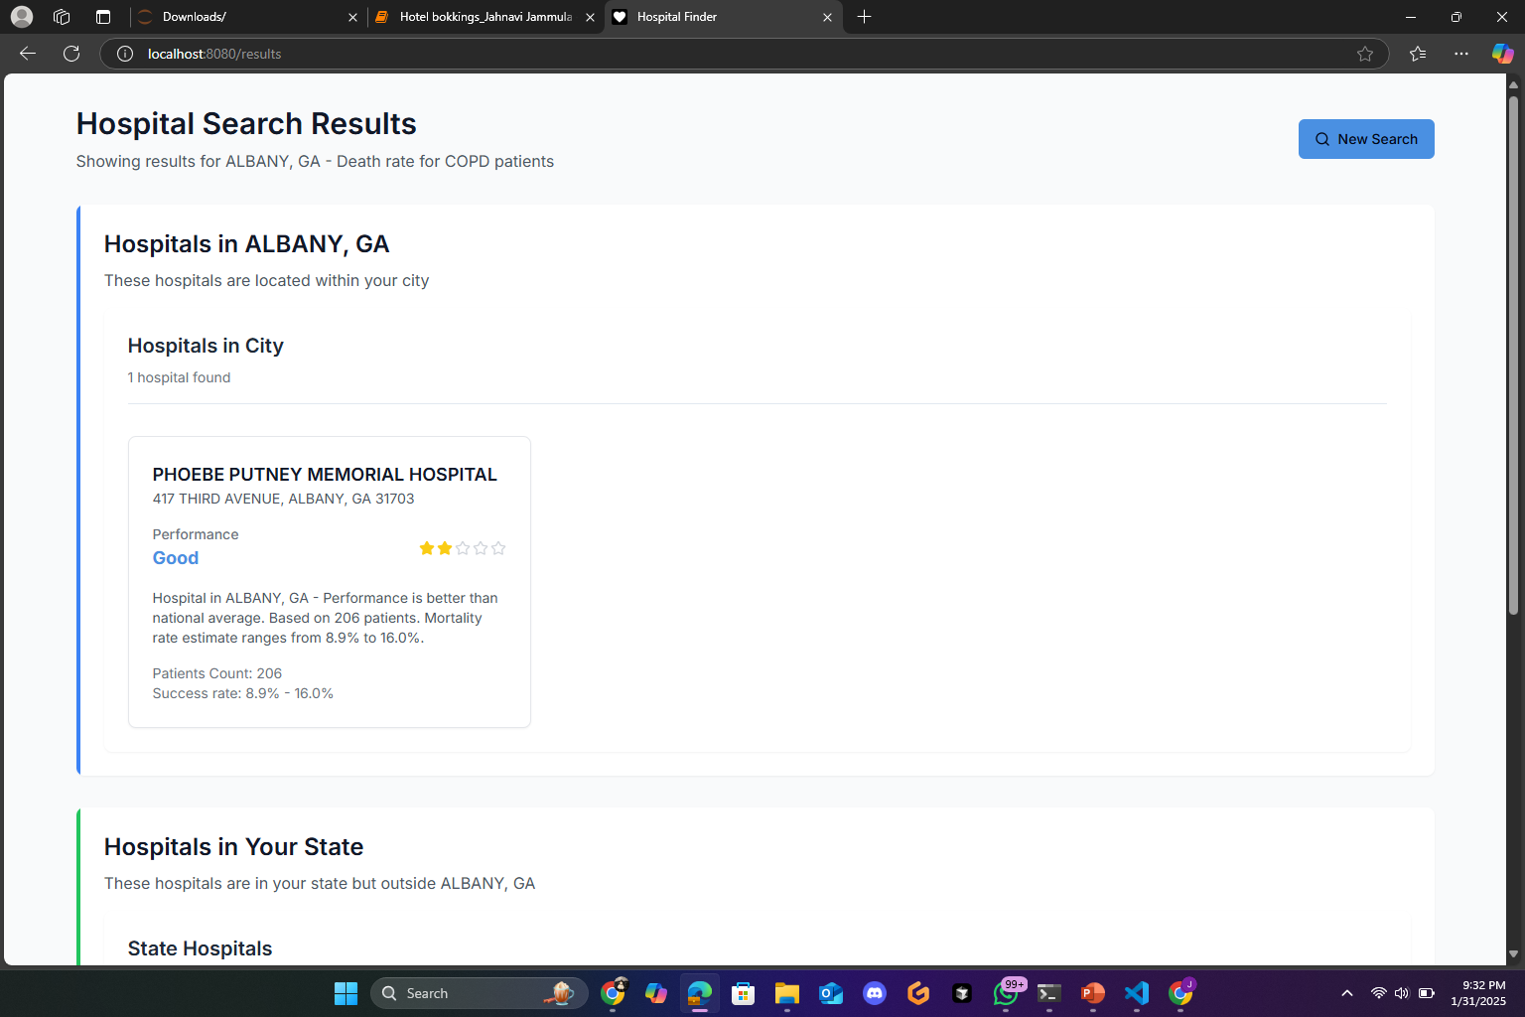
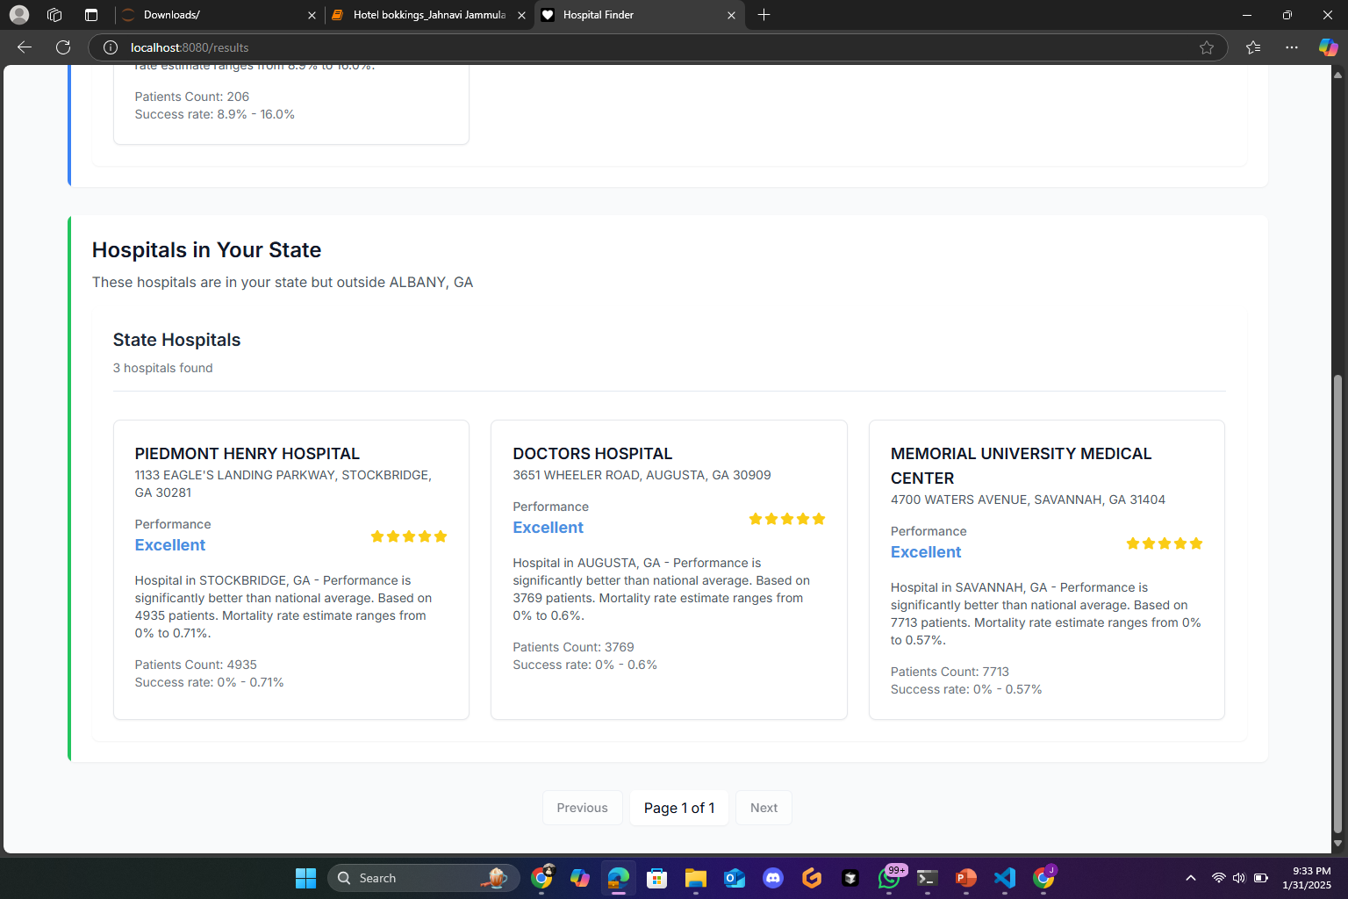
Hospital Search Results:

Slide 25
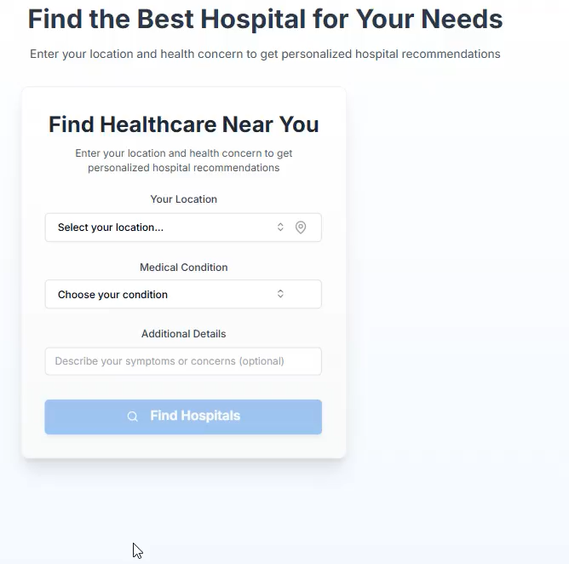

Slide 26

Thank You

